Slide 1

Lecture 24
GIT

Slide 2

Why Git?
A mechanism which allows you to keep track of the code base.
Allows multiple teams to work together and share the same code base.
Keeps track of each record and resolves conflict in case of editing the same code.

Slide 3
Record your changes (Commit)
Commit registers your codebase in the local repo.

Slide 4
Update your changes Online (PUSH)
Push pushes your code to the online repo.

Slide 5
Download changes FROM Online (PUSH)
Pull pushes your code to the online repo.

Slide 6
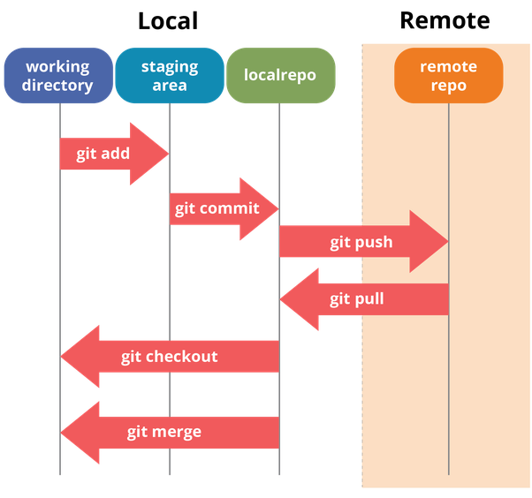
Understanding Git flow

Slide 7
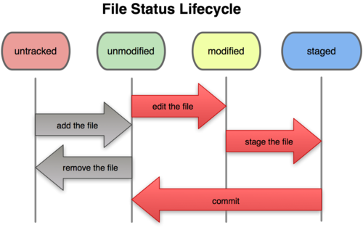

Slide 8
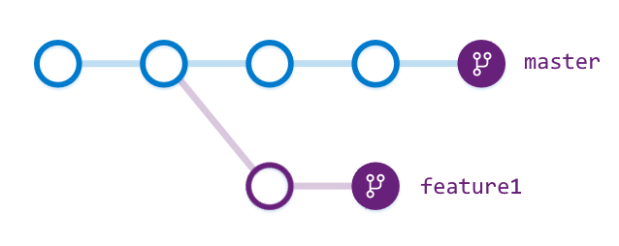
Branches
Branches allow you to extend a separate codebase from the main tree and codebase into it.

Slide 9
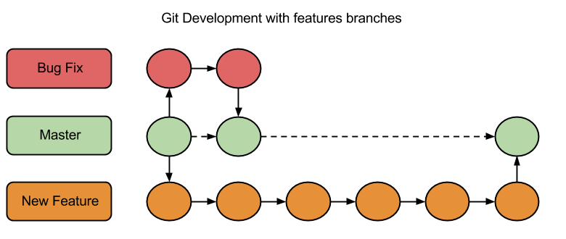
Merging
Using Git, multiple branches can be merged together.

Slide 10
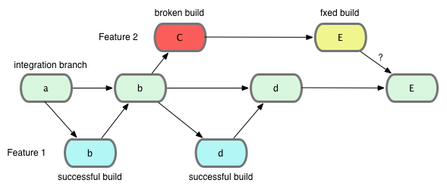
Branches
We can create as many branches as needed and can be merged on any level as needed.

Slide 11
Branches
Create a new branch
git checkout –b newBranch
View currently checked out branch
git branch

Slide 12

Branches
Remote
myBranch1
Master
Master
myBranch2

Slide 13
Branches
Remote
myBranch1
Master
Master
PUSH
myBranch2
myBranch2

Slide 14
Branches
myBranch1
Master
PULL
Master
myBranch2
myBranch2
Remote

Slide 15
Branches
myBranch1
Master
Master
PULL
myBranch2
myBranch2
Remote

Slide 16
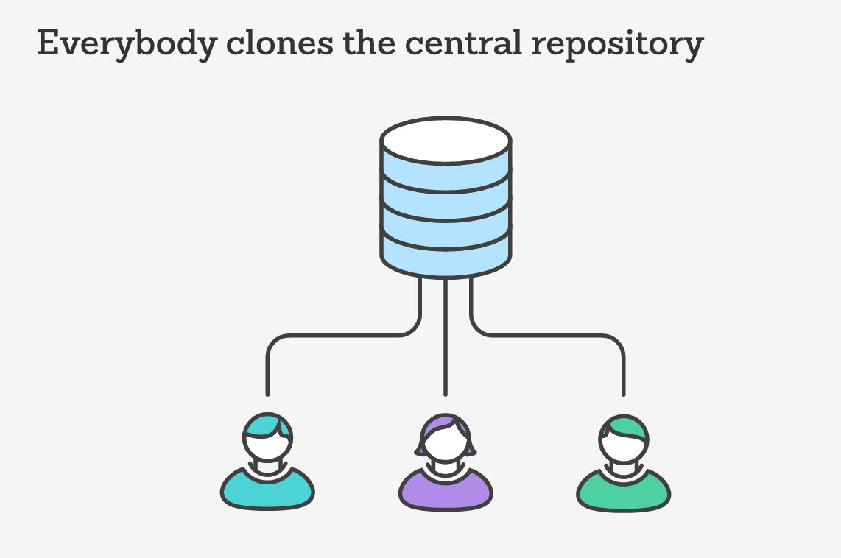
Collaboration
Collaboration allows to include
one on more persons in our
repository

Slide 17

Collaboration

Slide 18
Origin
Origin is an alias to the remote git repo
Using origin allows to push or pulling without specifying the full address of the target repo.
Example>
git pull origin master
git repo address

Slide 19
Merging
Merging allows us to add the content of branch into another
branch
MERGING

Slide 20
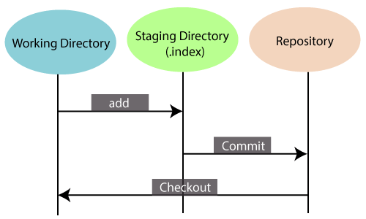
GIT Index

Slide 21
Conflicts
Conflict is a scenario in which a same file has been modified by either two branches or two users and a commit operation is being performed.
1). Branch to branch conflict
2). User to User conflict

Slide 22
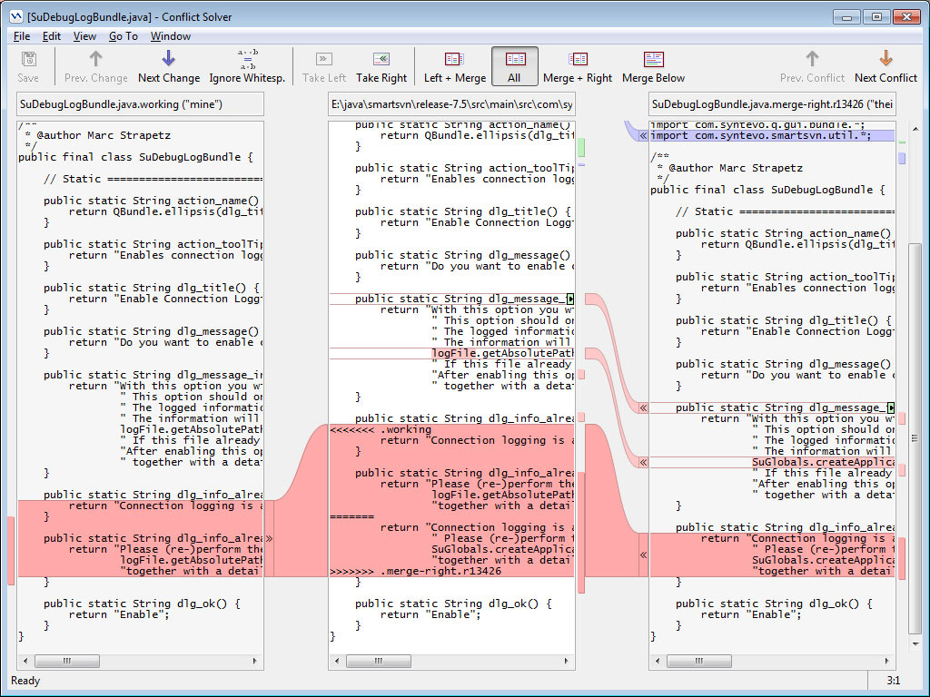
Resolving conflicts
Fortunately, most smart GIT managers are equipped with conflict resolver which are smart enough and handy for resolving commits.

Slide 23
Origin
Link local repo with another end
git remote add origin https://github.com/user/repo.git

Slide 24
Head
Head refers to the last commit in the currently checked-out branch.
Example>
git show head

Slide 25
Reset
git reset helps in discarding the changes we do need to take in.

Slide 26
Stashing
Stashing allows us to keep a record of our source content independent of any branch.
Example>
Git stash myStash
Stashing
Stashed work
myBranch1

